Slide 1
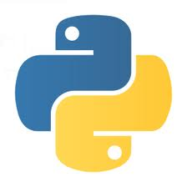
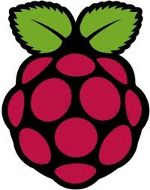
Programming Python on a Raspberry Pi
Daley Chetwynd
@dchetwynd

Slide 2
Introduction
What is a Raspberry Pi?
Raspberry Pi aims and opportunities
Raspberry Pi hardware
Raspberry Pi distributions
Why Python and Raspberry Pi?
Raspberry Pi Python development environments
Code examples
Conclusions

Slide 3
What is a Raspberry Pi?
Raspberry Pi is a credit card-sized single-board computer for teaching kids programming
Inspired by BBC Micro
Available for under £30 (excluding peripherals)
Released in February 2012 to huge demand
First boards shipped in April and May
Approximately 20,000 Raspberry Pi devices currently sold
Provided by the Raspberry Pi Foundation

Slide 4
Raspberry Pi Aims
Introduce school kids to programming
Return to hobby programming (BBC Micro, ZX Spectrum, Commodore 64)
Provide cheap computers to children and schools
Provide alternative to current ICT curriculum, criticised by Eric Schmidt and others
Raspberry Pi Foundation will work closely with schools to support Raspberry Pi use
Raspberry Pi to be used internationally in developing countries

Slide 5
Raspberry Pi Hardware
Model A and Model B versions available
700 MHz ARM11 processor
256MB RAM, shared with GPU
Model B has 2 USB ports, Model A has 1
Ethernet port, no wireless
HDMI output, can play 1080p video
5V Micro USB power source
8 General Purpose Input Output (GPIO) chips on board
SD card slot, requires SD card to be bought separately

Slide 6
Raspberry Pi Distributions
Requires bootable Linux image on SD card
Current recommended distribution is Debian Squeeze
Arch Linux ARM distribution
Original supported distribution was Raspberry Pi Fedora 14 Remix
Fedora 17 Raspberry Pi remix currently being worked upon
Qton Pi is Embedded Linux platform and SDK for developing Qt5 applications on Raspberry Pi

Slide 7
Why Python and Raspberry Pi?
Python is main supported language on Raspberry Pi
Python available by default on Linux
Python is clear and human-readable
Python already popular for teaching programming
Python can be run from command-line, so does not require IDE
Rpi.GPIO package available on pypi for Raspberry Pi
Active helpful Python community available

Slide 8
Python environments
Debian Squeeze has Python 2.6
Fedora Remix has Python 2.7
Python 3 supported and available through apt-get or yum
Debian Squeeze uses SPE (Stani's Python Editor) and Geany
IDLE available through yum
Eclipse PyDev not supported through Fedora
Eclipse PyDev available for Debian Squeeze but slow
Vim always available!

Slide 9
Code Examples on Raspberry Pi

Slide 10
Conclusions
Raspberry Pi is a popular and cheap computing platform
Raspberry Pi has great potential for teaching programming
Raspberry Pi already has an active community of developer support
Python is main supported language on Raspberry Pi
Raspberry Pi hardware means not a desktop replacement!
Unsuited to heavyweight IDEs or programs
Python community has opportunity to get involved with Raspberry Pi project

